Slide 1
PPI –
what and why?
(and how)
Functional connectivity measure
A way of looking for voxels which may be functionally linked to a region of interest
Interaction between psychological context and physiological input

Slide 2

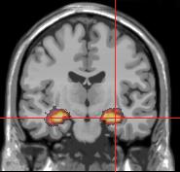
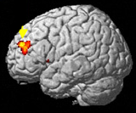
A hypothetical example:
Maze navigation task
Condition of interest: Navigating around a virtual reality maze
Control condition: Travelling passively through the maze
INTERACTION ?
Hippocampus → spatial memory
dl prefrontal cortex → planning

Slide 3
Key concept of PPI:
If two areas are interacting, their activity will go up and down in synch
This effect may be task dependent
It should be more than can be explained by the shared main effect of task

Slide 4
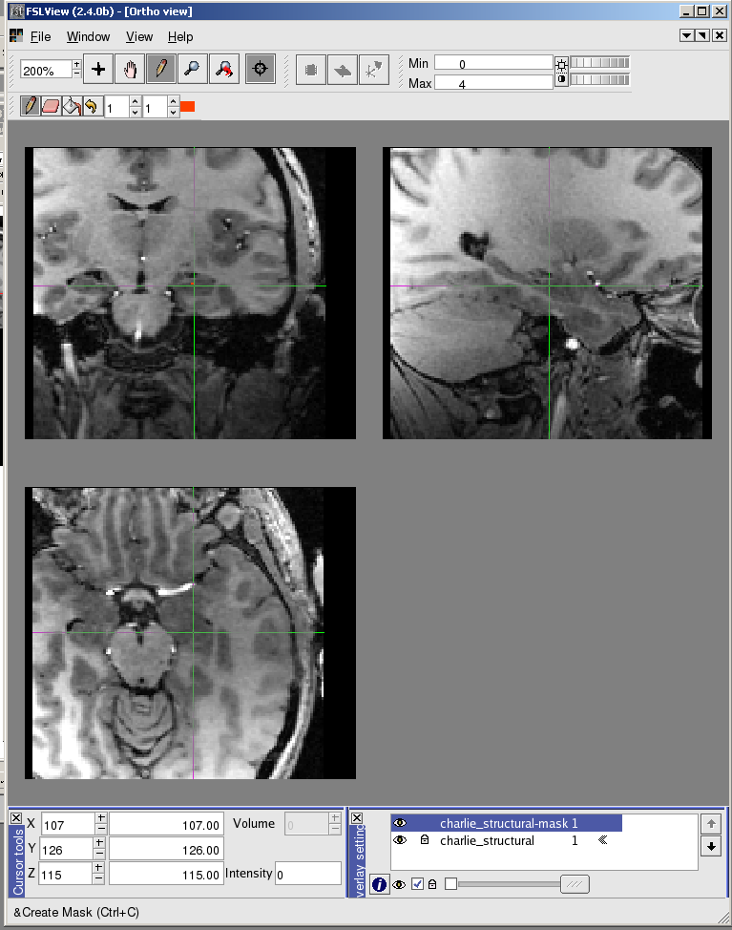
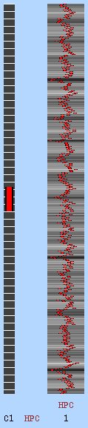
PPI strategy
“Look for all the voxels in which the level of activity is well explained by the level of activity in the hippocampus ROI”
>> fslmeants –i filtered_func.data
–o hippocampus.txt –m hpc_mask.nii.gz

Slide 5
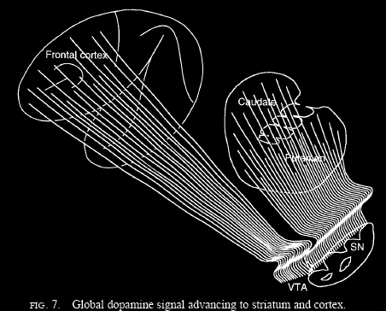
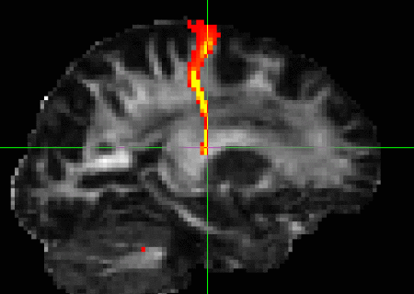


Problem:
Some brain areas will have a similar time-course to the seed area regardless of what task participants are doing
e.g.
→ Shared sub-cortical or neuro-modulatory input
Shared sensory input
Anatomical connections

Slide 6
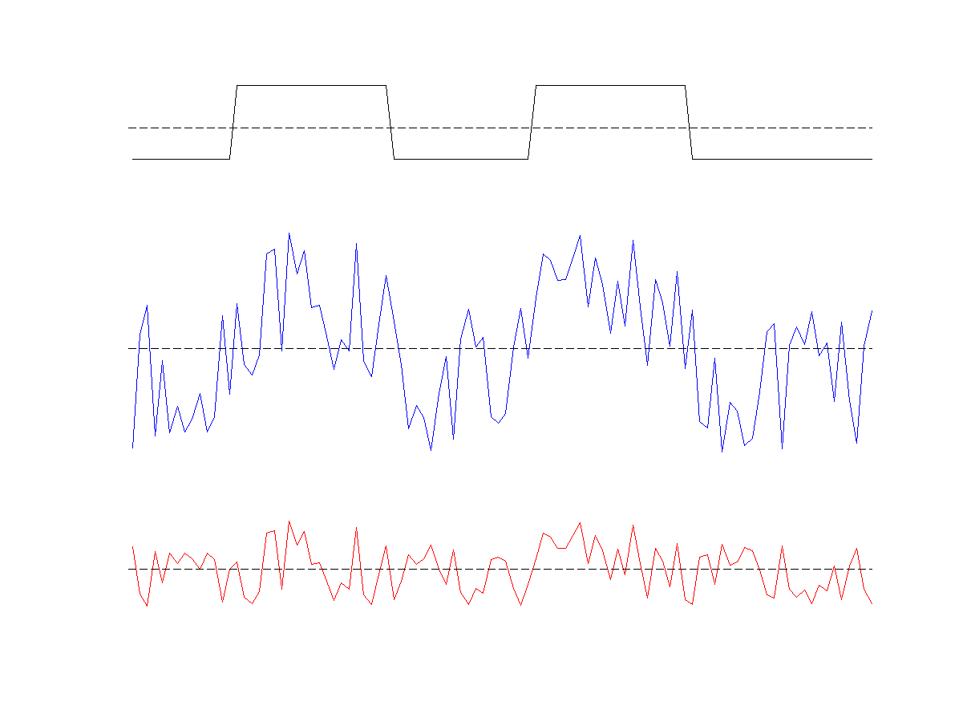
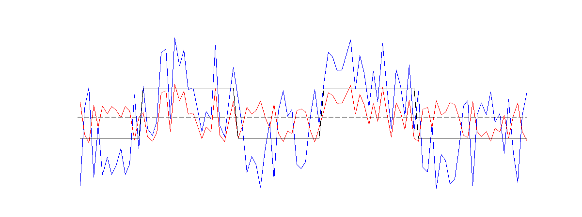
Solution: use a ‘psychophysiological interaction’ regressor
PSY main effect
(task variable)
.*
PHYS main effect
(time-course from
seed region)
PPI =
PSY.*PHYS
Overlay:

Slide 7
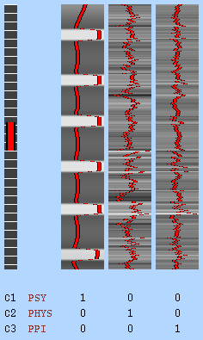
Caveat: covariates of no interest
→ Must include main effects (PSY and PHYS) in model
Design matrix

Slide 8

Considerations for running PPI
Hypothesis driven
(must choose seed region and task EV a-priori)
If you don’t have a hypothesis (!), or even if you do,
- It can be helpful to run MELODIC on group data first
- MELODIC gives you an idea of the different functional NETWORKS in your data
- ROIs from MELODIC blobs might work better as PPI seed regions
Should only use block designs (deconvolution issue)

Slide 9
How to do it
Choose your seed ROI and make masks
    either anatomical or based on foci of
    activity from GLM or MELODIC analysis
Extract time-course with fslmeants
Go into FEAT…

Slide 10
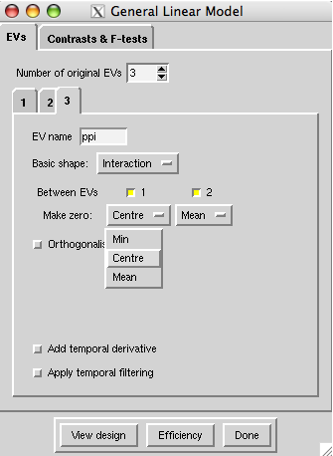
Setting up your PPI in Feat
In FEAT stats tab…
EV1 = your task regressor
EV2 = your ROI timecourse
EV3 = PPI
EV4 all your other
EV5 task regressors
EV6
Click on “basic shape” dropdown
Interaction
Between EVs 1 and 2
Make zero
centre for task regressor
mean for ROI timecourse
Orthogonalise, temporal derivative, temporal filtering --- OFF

Slide 11
The end.

Slide 12



What do all those “mean” options mean?
zero min
zero mean
zero centre

